Slide 1
GS5020 Writing a Literature Review
Presented by Ranga Rodrigo
23 May 2021

Slide 2
Contents for Today
Summary from last week
Literature: Summary
Structure of an article
Citations and references
Publication process
Writing tips

Slide 3
Summary from Last Week

Slide 4
What Is the Dominant KPI (GOAL) of a Research?
PUBLICATIONS.
However, know that the process of making you an independent researcher is what is truly important.

Slide 5
Why Write?
To preserve knowledge.
For reproducibility.

Slide 6
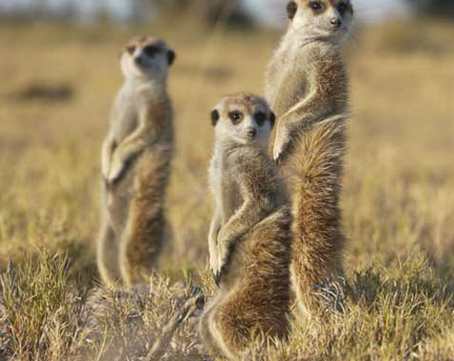
GOOD WRITING IS IMMITATION.
See a few well-known papers in the area and the journal.
https://www.tribes.co.uk/Wildlife/meet-the-meerkats
Notes:
Imitation does not mean copying here. It means following the structure, standards, and style appropriate to the particular forum.

Slide 7
Structure
I(L)MR(D)C

Slide 8
Steps in Writing the Literature Review

Slide 9
Steps in Writing the Literature Review
Finding and reading relevant articles
Organizing
Associating papers with areas and summarizing
Find key areas of knowledge
Provide transitions between areas
Organize them logically
Purpose of each paper
Assumptions
Main claims
Evaluating
Identify the gaps in these papers
How can these papers be applied
Why do the existing papers demand a new solution?
https://ecp.engineering.utoronto.ca/resources/online-handbook/components-of-documents/literature-reviews/

Slide 10
How to Search for Literature
Ask the supervisors. If the supervisor can point you to several key papers in recent well-known journals and conferences specific to your research, the problem is solved.
Know the top journals and conferences in your area.
Specify-and-search, know the topic.
List the questions to be answered
Do key-word searches in Google.
First: use an academic search engine such as Google Scholar or CiteSeer and some well-chosen keywords to find three to five recent.
Do one pass on each to get a sense of the work, then read their related work sections. You will find a thumbnail summary of the recent work, and perhaps, a pointer to a recent survey paper.
Second: Refer to (shared) citations within. These are the key papers and researchers in that area.
Refer to papers that cite these papers.
Then go to the websites of the key researchers and see where they’ve published recently. Identify top conferences and journals.
Third: go to the website for these top conferences and look through their recent proceedings
https://web.stanford.edu/class/ee384m/Handouts/HowtoReadPaper.pdf
Notes:
One pass: later.

Slide 11
Establishing Credibility
What are the major journals and conference in the specialized research field of yours?
Impact factors, quartile (Q1, Q2, etc.), $h$-index, Google Metrics help.
Who is the publisher (a scientific society, well-known publisher, a university or a commercial entity)?
Don’ts:
Do not read new journals not sponsored by a society, at least as a start.
Do not read journals that charge money for publishing, at least as a start.
Do not read journals that are only electronic or only in print, at least as a start.

Slide 12
How to Read a Paper?
https://web.stanford.edu/class/ee384m/Handouts/HowtoReadPaper.pdf
The Three-Pass Process
First Pass: Bird’s-Eye View
First pass: gives you a general idea about the paper (10 mins.).
Second pass: lets you grasp the paper’s content, but not its details (one hour).
Third pass: helps you understand the paper in depth (four or five hours for beginners).
1. Carefully read the title, abstract, and introduction
2. Read the section and sub-section headings, but ignore everything else
3. Read the conclusions
4. Glance over the references, mentally ticking off ones you’ve already read
Second Pass: Read with Care
Ignore what you can.
Look at figures, graphs, results. Is the work shoddy or excellent?
Mark relevant unread references for further reading.
After this: should be able to summarize.
Third Pass: Fully Understand
To fully understand a paper, particularly if you are reviewer, requires a third pass. The key to the third pass is to attempt to virtually re-implement the paper.
After this: innovations and failures identified.

Slide 13
Writing the Literature Review

Slide 14
Projecting Power and Authority [from Last Week]
Adopt a critical perspective in reading and relating the work of others.
The strategy is to develop a theme and then cite the work of relevant authors to support the argument, provide noteworthy examples, or counterexamples.
Example 1
Illuminatus (2010) conducted a study on the effects of seasonal light on major depression by comparing the rates of depressive illness among residents of Seattle and San Diego during different times of the year. He hypothesized that there would be more depression in the northern city than the southern city
and more depression during winter than during summer. His findings confirmed his hypotheses.
 | Aspect 1 | Aspect 2 | Aspect 3 | Aspect 4
Author 1
Author 2
Author 3
Author 4
Author 5
Horizontal preferred over vertical.
(Prof. Dias)
Rudestam and Newtorn, Surviving your dissertation : a comprehensive guide to content and process, 4th ed., Sage, 2015.

Slide 15
Projecting Power and Authority [from Last Week]
Adopt a critical perspective in reading and relating the work of others.
The strategy is to develop a theme and then cite the work of relevant authors to support the argument, provide noteworthy examples, or counterexamples.
Example 2
There is reason to believe that differences in seasonal light can affect the extent of depressive illness. For
instance, residents of Seattle, a northern city, are reported to have higher rates of depression than residents of San Diego, a southern city, and these differences are accentuated during the winter (Illuminatus, 2010), suggesting that relative darkness may exacerbate mood disorders.
Do not use quotations excessively.
Include that contradict as well.
Rudestam and Newtorn, Surviving your dissertation : a comprehensive guide to content and process, 4th ed., Sage, 2015.

Slide 16
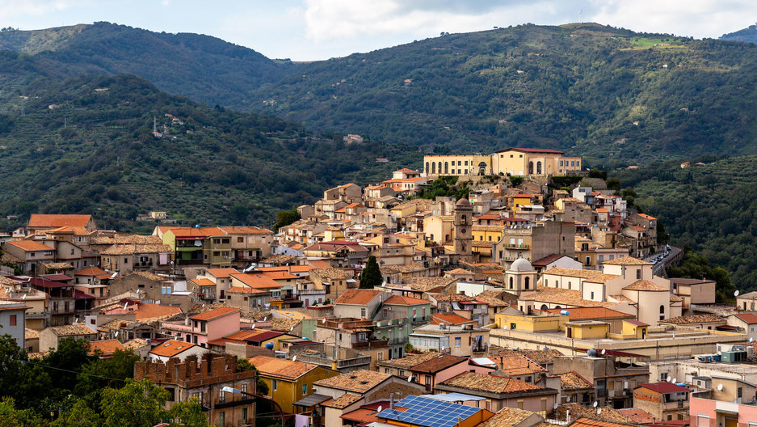
Background, Relevant vs. Very Relevant Literature
Background literature
(classic papers)
Abstract
Introduction
Relevant literature
Literature review
Method
Very relevant literature
(very similar to your work)
Results
Conclusion
Seminal and paradigm-shifting papers.
https://www.pri.org/stories/2019-09-16/small-town-italy-offers-houses-sale-less-espresso

Slide 17
Plagiarism
ALWAYS CITE, in the following cases:
When you quote two or more words verbatim, or even one word in a way unique to the source.
When you introduce facts you have found in a source.
When you paraphrase or summarize ideas, interpretations, or conclusions that you find in a source.
When you introduce information that is not common knowledge or that may be considered common knowledge in your field, that the reader may not know it.
When you borrow the plan or structure of a larger section of a source’s argument (e.g., using a theory from a source and analyzing the same three case studies that the source uses).
When you build on another’s method found either in a source or from collaborative work in a lab.
When you build on another’s program in writing computer code or on a not-commonly-known algorithm.
When you collaborate with others in producing knowledge.
Plagiarism is the use of another’s work, words, or ideas without attribution. The word “plagiarism” comes from the Latin word for “kidnapper” and is considered a form of theft, a breach of honesty in the academic community.
Three main categories:
Using a source’s language without quoting
Using information from a source without attribution, and paraphrasing a source in a form that stays too close to the original.
https://poorvucenter.yale.edu/writing/using-sources/understanding-and-avoiding-plagiarism/what-plagiarism

Slide 18
Writing a Literature Review: Quiz 1
In a literature review, the strategy is to develop a theme and then cite the work of relevant authors to support the argument, provide noteworthy examples, or counterexamples.
True
When quoting a small portion of text in from another source, it is sufficient if we use quotation marks.
False
If we paraphrase from a source, it is not necessary to cite.
False
We cannot republish our own work in its entirety or reuses portions of a previously written text while authoring a new work.
https://www.turnitin.com/blog/is-recycling-your-own-work-plagiarism
True

Slide 19
Literature Search Summary
Purpose: to know the state-of-the-art.
A congruent argument.
Projecting authority.
Background, relevant and very relevant literature.
Where to cite?

Slide 20
Structure of an Article

Slide 21
General-Specific-General
An article begins with broad general statements, progressively narrows the specifics of your study, and then broadens out again to more general considerations.
Writing the Empirical Journal Article by Daryl J. Bem

Slide 22
Abstract
Introduction
Method
I(L)MR(D)C
Results
Conclusion

Slide 23
Structure of a Thesis
Title Page
Abstract
Table of Contents
List of Figures
List of Tables
Introduction
Literature Survey
Material and Methods
Results
Discussion
Conclusions
Acknowledgments
References
Appendices
Abstract
Introduction
Method
Results and Discussion
Conclusion
References
http://www.ldeo.columbia.edu/~martins/sen_sem/thesis_org.html

Slide 24
Abstract (Prof. Philip Koopman)
Motivation
Why do we care about the problem and the results?
Problem Statement
What problem are you trying to solve? What is the scope of your work (a generalized approach, or for a specific situation)?
Approach
How did you go about solving or making progress on the problem?
Results
Conclusion
What's the answer?
What are the implications of your answer?
https://users.ece.cmu.edu/~koopman/essays/abstract.html

Slide 25
Revision
Yourself (many times)
Others (expert, a general reader in the field, a non-field reader)
Revise again

Slide 26
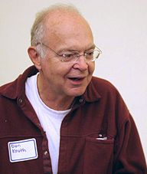
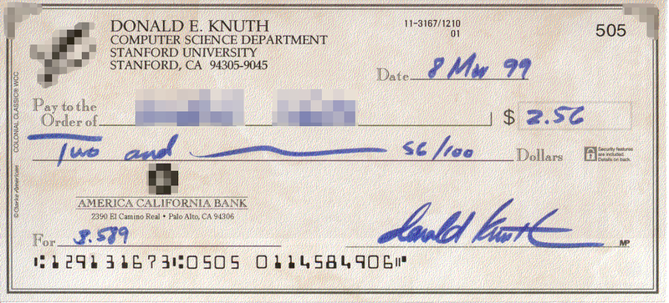
TeX and LaTeX
TeX is a typesetting system designed and mostly written by Donald Knuth (1978).
Donald Ervin Knuth (born in 1938) is a computer scientist, mathematician, and Professor Emeritus at Stanford University. He is the author of the multi-volume work, The Art of Computer Programming. Knuth has been called the "father" of the analysis of algorithms.
LaTeX is a document preparation system and document markup language. It is the standard for the publication of scientific documents.
LaTeX uses the TeX typesetting program for formatting its output and is itself written in the TeX macro language.
Notes:
Knuth used to pay a finder's fee of $2.56 for any typographical errors or mistakes discovered in his books, because "256 pennies is one hexadecimal dollar", and $0.32 for "valuable suggestions". According to an article in the Massachusetts Institute of Technology's Technology Review, these Knuth reward checks are "among computerdom's most prized trophies".

Slide 27
Citations and References

Slide 28
Reference Managers
Citation Styles
EndNote,
Reference Manager
RefWorks
Mendeley
IEEE style (Institute of Electrical and Electronics Engineers): numbered e.g., [1].
APA style (American Psychological Association): author-date, e.g., Schmidt and Oh (2016), (Schmidt & Oh, 2016)
MLA Style Manual (Modern Language Association): author-page.
Chicago style (Chicago Manual of Style): author-date, author-date-page.
Harvard style
https://www.overleaf.com/project/5f802e5024ea5a000136fd46
Adding Citations and References in Microsoft Word: https://youtu.be/Rjl7sDKYxGE
https://web.archive.org/web/20180915145204/https://library.sydney.edu.au/subjects/downloads/citation/Harvard_Complete.pdf

Slide 29
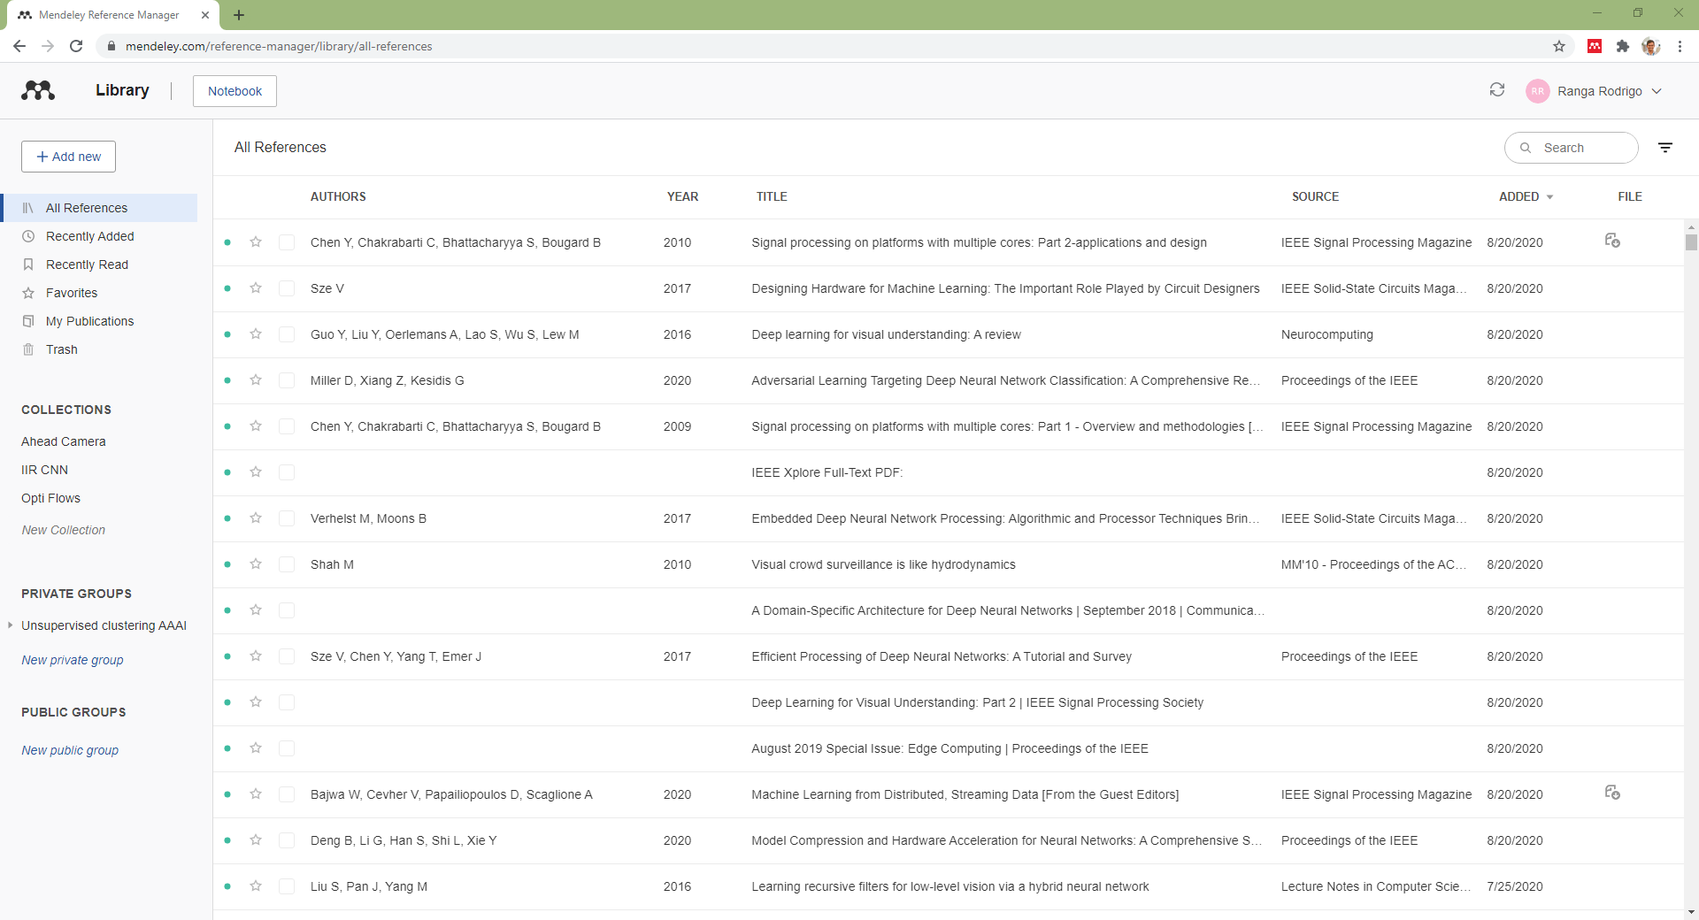

Slide 30
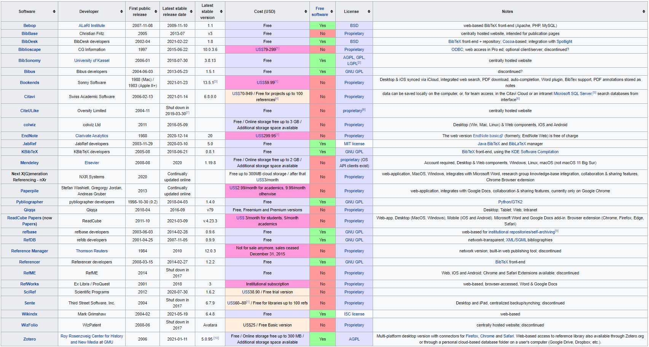
Discussion on Reference Managers
https://en.wikipedia.org/wiki/Comparison_of_reference_management_software

Slide 31
IEEE References
https://ieeeauthorcenter.ieee.org/wp-content/uploads/IEEE-Reference-Guide.pdf

Slide 32
Required Fields in Refences
Type | Description | Required Fields
article | An article from a journal or magazine. | author, title, journal, year, volume, number, pages, month. Optional: note.
book | A book with an explicit publisher | author or editor, title, publisher, year. Optional fields: volume or number, series, address, edition, month, note.
conference (inproceedings) | An article in a conference proceedings. | author, title, booktitle, year, pages, address, month. Optional fields: editor, volume or number, series, organization, publisher, note.
phdthesis | A PhD thesis. | author, title, school, year. Optional fields: type, address, month, note.
website |  | author, title, date of publication, website, url, date of access.
Use refereed material. Avoid websites.
https://www.andy-roberts.net/res/writing/latex/bibentries.pdf

Slide 33
IEEE Refences in Text
References need not be cited in the text. When they are, they appear on the line, in square brackets, inside the punctuation. Grammatically, they may be treated as if they were footnote numbers, e.g.:
as shown by Brown [4], [5]; as mentioned earlier [2], [4]–[7], [9]; Smith [4] and Brown and Jones [5]; Wood et al. [7]
NOTE: Use et al. when three or more names are given for a reference cited in the text. or as nouns:
as demonstrated in [3]; according to [4] and [6]–[9].
https://ieeeauthorcenter.ieee.org/wp-content/uploads/IEEE-Reference-Guide.pdf

Slide 34
IEEE Style Example
https://www.overleaf.com/project/5f802e5024ea5a000136fd46
https://ieeeauthorcenter.ieee.org/wp-content/uploads/IEEE-Reference-Guide.pdf

Slide 35
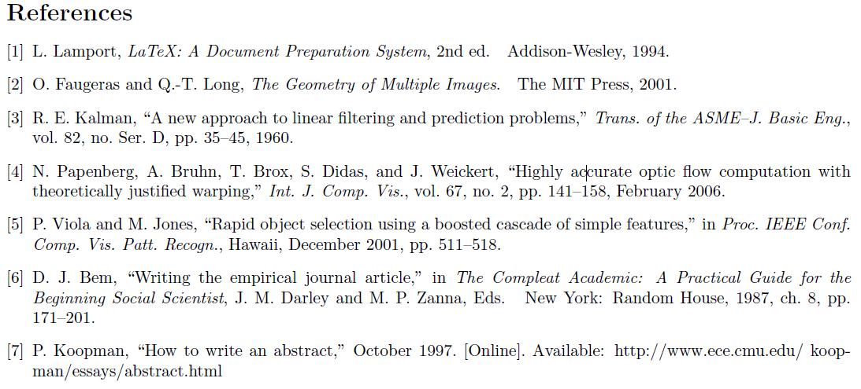
IEEE Style Example Cntd.: References
https://ieeeauthorcenter.ieee.org/wp-content/uploads/IEEE-Reference-Guide.pdf

Slide 36
MLA Style
Modern Language Association

Slide 37
MLA In-Text Citation Examples
Author's name in text | Magny develops this argument (67-69).
Author's name in reference | This argument has been developed elsewhere (Magny 67-69).
Two authors' names in reference | The most notorious foreign lobby in Washington is the "Sugar Mafia" (Howe and Trott 134).
Quotation found in indirect or "secondhand" source | The philosopher Alain states that "admiration is not pleasure but a kind of attention. . ." (qtd. in Magny 66).
1 | Author’s name(s) / Editor’s name(s) | .
2 | Title of the article or source | .
3 | Title of the container | ,
4 | Other contributors | ,
5 | Volume or version | ,
6 | Number or edition | ,
7 | Publisher | ,
8 | Publication date | ,
9 | Web address (URL) or location | .
https://pitt.libguides.com/citationhelp/mla8thedition

Slide 38
APA Style

Slide 39
Proper Tense for an APA Paper
MLA style:
The scholarly issue at work here is the construction of reality. Cohen, Adoni, and Bantz label the construction a social process “in which human beings act both as the creators and products of the social world” (34). These writers identify three categories (34–35).
APA style:
The scholarly issue at work here is the
construction of reality. Cohen, Adoni, and Bantz (2016) labeled the construction a social process “in which human beings act both as the creators and products of the social world” (p. 34). These writers have identified three categories.
APA style requires that you use the present tense for generalizations and references to stable conditions, but it requires the present perfect tense or the past tense for sources cited (e.g., the sources have tested a hypothesis or the sources reported the results of a test). These next sentences use tense correctly for APA style:
The danger of steroid use exists for every age group, even youngsters. Lloyd and Mercer (2016) reported on six incidents of liver damage to 14-year-old swimmers who used steroids.
James D. Lester and James D. Lester Jr. Writing Research Papers: A Complete Guide, 15 ed., 2018.

Slide 40
APA In-Text Citation Examples
Last name of the author and the year of publication | Nguyen (2016) has advanced the idea of combining the social sciences and mathematics to chart human behavior.
Not using the author’s name in text | One study has advanced the idea of combining the social sciences and mathematics to chart human behavior (Nguyen, 2016).
Page no. if exact words quoted | Nguyen (2016) has advanced the idea of “soft mathematics,” which is the practice of “applying mathematics to study people’s behavior” (p. B4).
More than one author | Werner and Throckmorton (2016) offered statistics on the toxic levels of water samples from six rivers. It has been reported (Werner & Throckmorton, 2016) that toxic levels exceeded the maximum allowed each year since 2012.
For three to five authors, name them all in the first entry (e.g., Torgerson, Andrews, Smith, Lawrence, & Dunlap, 2015), but thereafter use “et al.” (e.g., Torgerson et al., 2015). For six or more authors, employ “et al.” in the first and in all subsequent
instances (e.g., Fredericks et al., 2016).
James D. Lester and James D. Lester Jr. Writing Research Papers: A Complete Guide, 15 ed., 2018.

Slide 41
Glasman-Deal, Hilary, Science research writing for non-native speakers of English, 1st ed., Imperial College Press, 2010.
Stephen Bailey, Academic Writing: A Handbook for International Students, 4th ed., Routledge, 2015.
Heather Silyn-Roberts, Writing for Science and Engineering: Papers, Presentations and Reports, 2nd ed., Elsevier, 2013.
Ann Raimes, Grammar Troublespots: A Guide for Student Writers, 3rd ed., Cambridge University Press, 2004.

Slide 42
APA Style Example

Slide 43
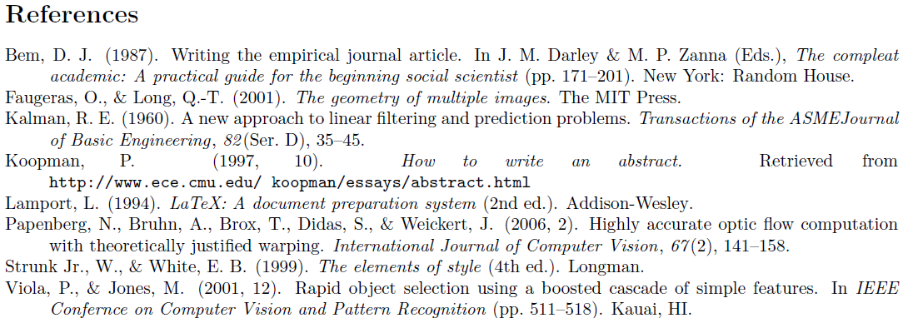
APA Style Example Cntd.: References
https://www.overleaf.com/project/60a76038fecf4094fa133673

Slide 45
Publication Process

Slide 46
Publication Process
Write the Manuscript
Submit to the Journal
Editor Sends for Peer Review
Accept with revisions or rejected with encouragement to resubmit
Rejected with no encouragement to resubmit
Editor’s Decision
Re-Do Some Work, Thoroughly Revise
Thoroughly Revise
Accept
Revise
Submit Revised Paper
Submit Camera-Ready Paper
Submit as a Fresh Paper

Slide 47
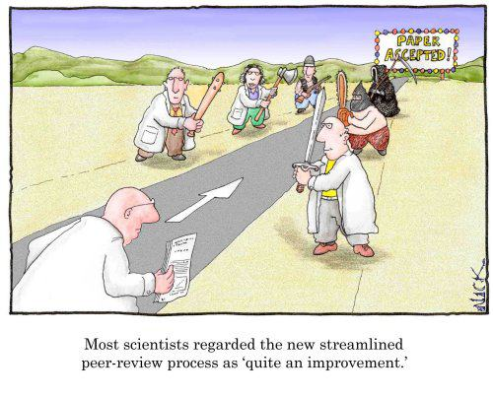
Peer-Review Process
http://www.justinholman.com/2012/03/24/academic-peer-review/

Slide 48
Typical Peer-Review Process in a Journal
Editor Assigns the Submission to an Associate Editor
Associate Editor Assigns Reviewers
Reviewers Review the Paper
Associate Editor Receives Reviews and Confidential Reviews
Associate Editor Makes the Decision to Accept, Major Revisions, or Reject
Editor Communicates the Decision

Slide 49
Peer-Review Types
Single-Blind Review
Reviewers are hidden from authors
Double-Blind Review:
Both reviewers and authors remain anonymous.
Open Review
Reviewers and authors are known to each other.
Note: A conflict of interest arises when a reviewer and author have a disproportionate amount of respect or disrespect for each other.
http://www.elsevier.com/reviewers/peer-review, http://en.wikipedia.org/wiki/Peer_review

Slide 50
Typical Review Criteria
Category (application, research, survey)
Correctness
Relevance (to the readers of the journal)
Readability
Originality
Contribution
Utility
Results and comparison
References

Slide 51
Discussion on CVPR Reviewer Instructions
http://cvpr2020.thecvf.com/submission/main-conference/reviewer-guidelines#reviewer-guidelines
https://sites.google.com/view/making-reviews-great-again/
http://cvpr2020.thecvf.com/sites/default/files/2019-09/CVPRReviewerTutorial.pptx

Slide 52
Writing Tips

Slide 53
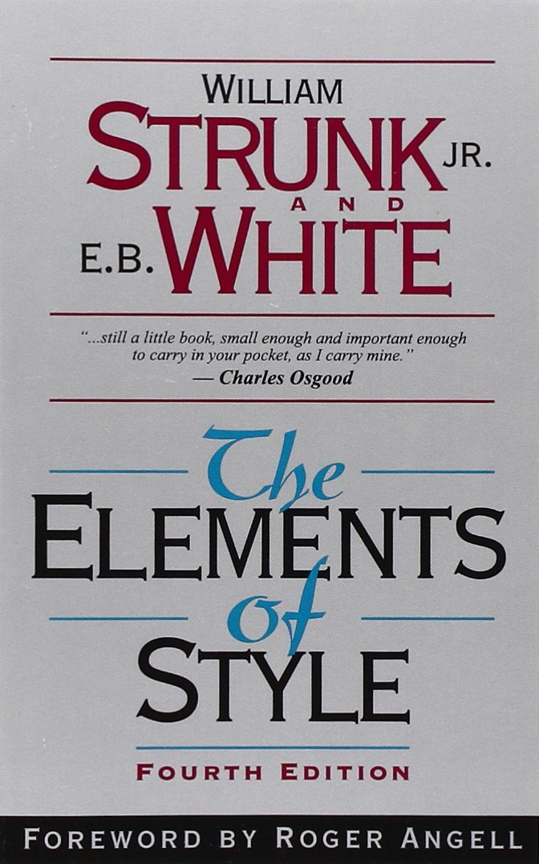
STYLE
From Strunk Jr. and White except when noted otherwise.

Slide 54
12. Choose a suitable design and hold to it.
Contrast: a love letter. Planning must be a deliberate prelude to writing.
13. Make the paragraph the unit of composition
Firs sentence in the topic. It also a sentence of transition.
14. Use the active voice
Start from a skeleton. Then fill in the text.
Carefully choose the order of sentence within.
Last sentence is the conclusion.
The active voice is usually more direct and vigorous than the passive.
15. Put statements in positive form
Make definite assertions. Avoid tame, colorless, hesitating, noncommittal language.
Use the word not as a means of denial or in antithesis, never as a means of evasion.

Slide 55
16. Use definite, specific, concrete language
Prefer the specific to the general, the definite to the vague, the concrete to the abstract.
17. Omit needless words
Vigorous writing is concise. A sentence should contain no unnecessary words, a paragraph no unnecessary sentences, for the same reason that a drawing should have no unnecessary lines and a machine no unnecessary parts. This requires not that the writer make all sentences short, or avoid all detail and treat subjects only in outline, but every word tell.

Slide 56
Paragraph
Paragraphs are the building blocks of papers. The unity and coherence of ideas among sentences is what constitutes a paragraph.
A paragraph is “a group of sentences or a single sentence that forms a unit”.
A paragraph speaks about one key idea.
Canada is one of the best countries in the world to live in.
First, Canada has an excellent health care system. All Canadians have access to medical services at a reasonable price. Second, Canada has a high standard of education. Students are taught by well‐trained teachers and are encouraged to continue studying at university. Finally, Canada's cities are clean and efficiently managed. Canadian cities have many parks and lots of space for people to live.
As a result, Canada is a desirable place to live.
Topic (key) sentence
Supporting details
Closing (conclusion) sentence
Transitions
https://writingcenter.unc.edu/tips-and-tools/paragraphs/
https://www.csun.edu/sites/default/files/Auerbach-Handout-Paragraph-Writing-Examples.pdf

Slide 57
Paragraph: Example 2
The rate of home ownership varies widely across the developed world. Germany, for instance, has one of the lowest rates, at 42 per cent, while in Spain it is twice as high, 85 per cent. Both the USA and Britain have similar rates of about 70 per cent. The reasons for this variation appear to be more cultural and historic than economic, since high rates are found in both rich and poorer countries. There appears to be no conclusive link between national prosperity and the number of homeowners.
Stephen Bailey, Academic Writing: A Handbook for International Students, 4th ed., Routledge, 2015.

Slide 58
Paragraph: Example 2
The rate of home ownership varies widely across the developed world. Germany, for instance, has one of the lowest rates, at 42 per cent, while in Spain it is twice as high, 85 per cent. Both the USA and Britain have similar rates of about 70 per cent. The reasons for this variation appear to be more cultural and historic than economic, since high rates are found in both rich and poorer countries. There appears to be no conclusive link between national prosperity and the number of homeowners.
TOPIC SENTENCE
SUPPORTING DETAILS: EXAMPLE 1
SUPPORTING DETAILS: EXAMPLE 2
SUPPORTING DETAILS: Reason
CLOSING (CONCLUSION)
Stephen Bailey, Academic Writing: A Handbook for International Students, 4th ed., Routledge, 2015.

Slide 59
Paragraph: Quiz 2
 | Despite this, many countries encourage the growth of home ownership.
 | Ireland and Spain, for instance, allow mortgage payers to offset payments against income tax.
 | It is widely believed that owning your own home has social as well as economic benefits.
 | Compared to renters, homeowners are thought to be more stable members of the community who contribute more to local affairs.
 | In addition, neighbourhoods of owner occupiers are considered to have less crime and better schools.
 | But above all, home ownership encourages saving and allows families to build wealth.
Stephen Bailey, Academic Writing: A Handbook for International Students, 4th ed., Routledge, 2015.

Slide 60
An Example Paragraph form a Literature Review
Structure from Motion. Traditional methods such as Structure from Motion (SfM) [10] can reconstruct the 3D structure of individual rigid scenes given as input multiple views of each scene and 2D keypoint matches between the views. This can be extended in two ways. First, monocular reconstruction methods can perform dense 3D reconstruction from a single image without 2D keypoints [68, 58, 19]. However, they require multiple views [19] or videos of rigid
scenes for training [68]. Second, Non-Rigid SfM (NRSfM) approaches [4, 41] can learn to reconstruct deformable objects by allowing 3D points to deform in a limited manner between views, but require supervision in terms of annotated 2D keypoints for both training and testing. Hence, neither family of SfM approaches can learn to reconstruct deformable objects from raw pixels of a single view.
Shangzhe Wu, Christian Rupprecht, Andrea Vedaldi, Unsupervised Learning of Probably Symmetric Deformable 3D Objects from Images in the Wild, CVPR, 2020. [Best-Paper Award]

Slide 61
Paragraph: Quiz 2
TOPIC | Despite this, many countries encourage the growth of home ownership.
SUPPORTING DETAILS: EXAMPLE | Ireland and Spain, for instance, allow mortgage payers to offset payments against income tax.
SUPPORTING DETAILS: MAIN REASON | It is widely believed that owning your own home has social as well as economic benefits.
SUPPORTING DETAILS | Compared to renters, homeowners are thought to be more stable members of the community who contribute more to local affairs.
SUPPORTING DETAILS | In addition, neighbourhoods of owner occupiers are considered to have less crime and better schools.
CONCLUSION | But above all, home ownership encourages saving and allows families to build wealth.
Stephen Bailey, Academic Writing: A Handbook for International Students, 4th ed., Routledge, 2015.

Slide 62
Paragraph: Summary
A paragraph is a group of sentences that deal with a single topic. Dividing up the text into paragraphs helps both writer and reader to follow the argument more clearly.
The length of paragraphs varies significantly according to text type but should normally be no less than four or five sentences.
Usually (but not always), the first sentence introduces the topic. Other sentences may give definitions, examples, extra information, reasons, restatements and summaries.
The parts of the paragraph are linked together by the phrases and conjunctions. They guide the reader through the arguments presented.
Stephen Bailey, Academic Writing: A Handbook for International Students, 4th ed., Routledge, 2015.

Slide 63
Using Active Voice
There were a great number of dead leaves lying on the ground.
At dawn the crowing of a rooster could be heard.
The reason he left college was that his health became impaired.
It was not long before she was very sorry that she had said what she had.

Slide 64
Using Active Voice
There were a great number of dead leaves lying on the ground. | Dead leaves covered the ground.
At dawn the crowing of a rooster could be heard. | The cock’s crow came with dawn.
The reason he left college was that his health became impaired. | Failing health compelled him to leave college.
It was not long before she was very sorry that she had said what she had. | She soon repented her words.

Slide 65
Putting Statements in Positive Form
He was not very often on time.
She did not think that studying Latin was a sensible way to use one's time.
The Taming of the Shrew is rather weak in spots. Shakespeare does not portray Katharine as a very admirable character, nor does Bianca remain long in memory as an important character in Shakespeare's works.

Slide 66
Putting Statements in Positive Form
He was not very often on time. | He usually came late.
She did not think that studying Latin was a sensible way to use one's time. | She thought the study of Latin a waster of time.
The Taming of the Shrew is rather weak in spots. Shakespeare does not portray Katharine as a very admirable character, nor does Bianca remain long in memory as an important character in Shakespeare's works. | The woman in The Taming of the Shrew are unattractive. Katherine is disagreeable, Bianca insignificant.

Slide 67
Using Definite, Specific, Concrete Language
A period of unfavorable weather set in. | It rained every day for a week.
He showed satisfaction as he took possession of his well-earned reward. | He grinned as he pocketed the coin.

Slide 68
Omitting Needless Words
the question as to whether | whether
there is no doubt but that | no doubt
used for fuel purposes | used for fuel
he is a man who | he
in a hasty manner | hastily
this is a subject that | this subject
Her story is a strange one. | her story is strange.
the reason why is that | because
owing to the fact that | since (because)
in spite of the fact that | though (although)

Slide 69
Assignment
Write a one-paragraph (or two-paragraph) literature review using the papers that you listed in the previous assignment.
Thematic (emphasis is on the argument, not on the papers cited).
The structure of the paragraph (key sentence, supporting sentences, conclusion)
Citations and references correctly formatted with all required information.

Slide 70
Summary
Authoritative writing of literature review: themed.
Structure of an article: general to specific to general.
Citation and bibliography styles:
IEEE (brackets)
MLA (in-text citations)
APA (author-year)
Citations and references in Microsoft Word
Writing tips
From Stunk Jr. and White
Paragraph as he unit of construction
Style

